Slide 2
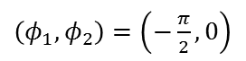
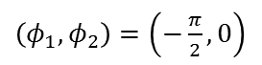
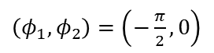
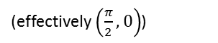
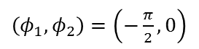
door
$\left(φ_{1},φ_{2}\right)=\left(−\frac{π}{2},0\right)$
$\left(φ_{1},φ_{2}\right)=\left(−\frac{π}{2},0\right)$
$\left(φ_{1},φ_{2}\right)=\left(−\frac{π}{2},0\right)$
$\left(φ_{1},φ_{2}\right)=\left(−\frac{π}{2},0\right)$
(effectively $\left(\frac{π}{2},0\right)$)
1
1
2
2
39 s
39 s
67 s
75 s
2
2
1
1
room

Slide 3
2 particle out of phase
t=0
t=1
t=2
t=3
t=4
1
1
1
1
1
2
2
2
2
2
After pushing off the walls they move toward each other

Slide 4


Slide 5
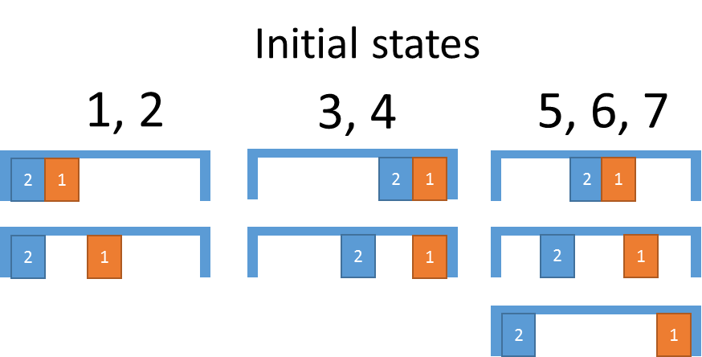
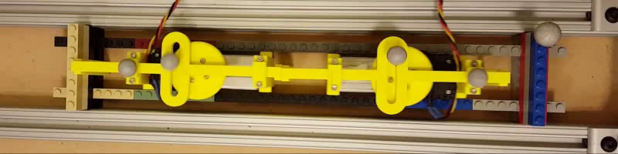
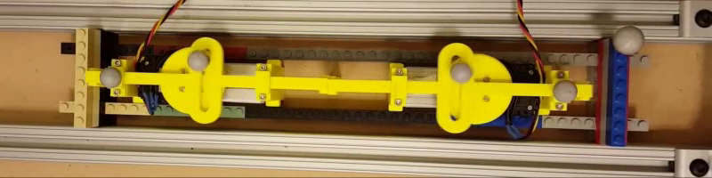
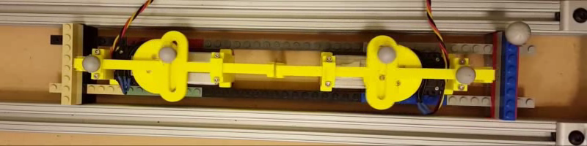
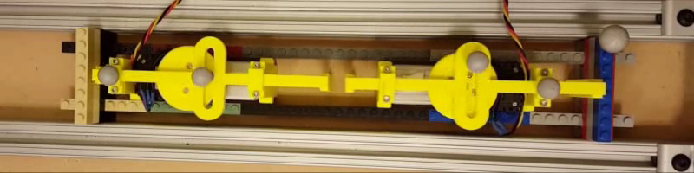
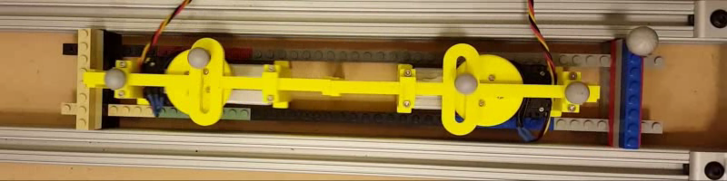

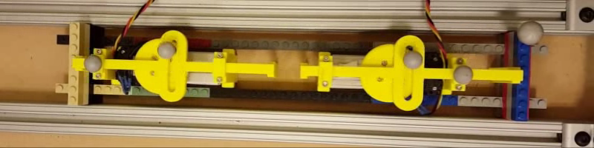
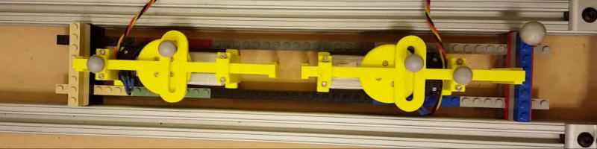
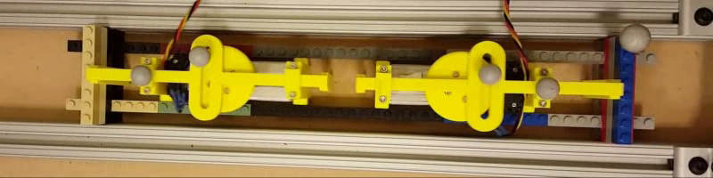
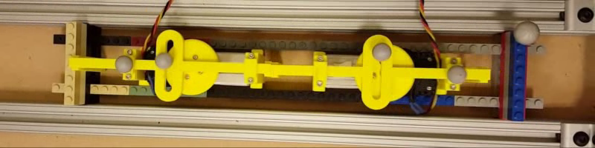
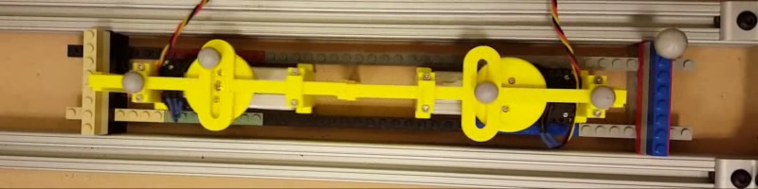



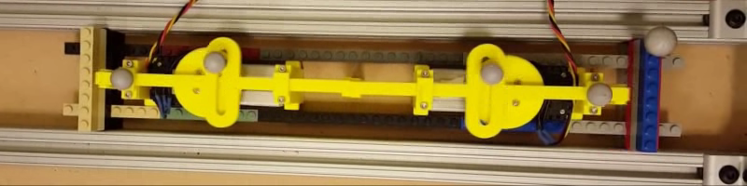
State: 1 5 6 4
frames: 1,12 13,14 15,21 22,26
State: 7 2 1 5
frames: 27,34 35,44 45,52 53,59

Slide 6
State: 1 5 6 4
frames: 1,12 13,14 15,21 22,26
State: 7 2 1 5
frames: 27,34 35,44 45,52 53,59

Slide 7
state | start dir s2 | start dir s1 | end dir s2 | end dir s1 | frame start | frame end | length
1 | cw | ccw |  | cw | 1 | 12 | 11
5 | cw | cw |  |  | 13 | 14 | 1
6 | cw | cw |  |  | 15 | 21 | 6
4 | ccw | cw |  |  | 22 | 26 | 4
7 | ccw | cw |  |  | 27 | 33 | 6
2 | ccw | ccw | cw |  | 34 | 44 | 10
1 | cw | ccw |  |  | 45 | 52 | 7
5 | cw | ccw |  | cw | 53 | 59 | 6
6 | cw | cw |  |  | 60 | 64 | 4
4 | cw | cw | ccw |  | 65 | 71 | 6
7 | ccw | cw |  |  | 72 | 77 | 5
2 | ccw | ccw | cw |  | 78 | 89 | 11
1 | cw | ccw |  |  | 90 | 97 | 7
5 | cw | ccw |  | cw | 98 | 102 | 4
6 | cw | cw |  |  | 103 | 107 | 4
4 | cw | cw | ccw |  | 108 | 118 | 10
7 | ccw | cw |  | ccw | 119 | 123 | 4
2 | ccw | ccw |  |  | 124 | 132 | 8
1 | cw | ccw |  |  | 133 | 138 | 5
5 | cw | ccw |  | cw | 139 | 147 | 8
6 | cw | cw |  |  | 148 | 150 | 2
4 | cw | cw | ccw |  | 151 | 164 | 13
7 | ccw | cw |  |  | 165 | 166 | 1
2 | ccw | ccw | cw |  | 167 | 177 | 10
1 | cw | ccw |  |  | 178 | 187 | 9
5 | cw | ccw |  | cw | 188 | 192 | 4
6 | cw | cw |  |  | 193 | 197 | 4
4 | cw | cw | ccw |  | 198 | 205 | 7
7 | ccw | cw |  | ccw | 206 | 212 | 6
2 | ccw | ccw |  |  | 213 | 217 | 4

